Slide 1
Laser Projectors
Projector Communication
Without LPM

Slide 2
Introduction
3
Projecting files stored on the projector via file name
4
7
Winsock
5
6
Projecting files stored on the computer via SPS, PLC
Samba Share
Hyperterminal
1
2
Web interface
FTP

Slide 3
Web interface
Connection
Network connection to projector via IP address
Interface access rights
Username and password “root” – all settings available
Purpose
To project PLOT files
Username and password “cps” – only some settings available
Alter the LPC.INI
Retrieve projector info/settings such as port number, client version, etc
Linux client mode required (since LPC 11.00)

Slide 4
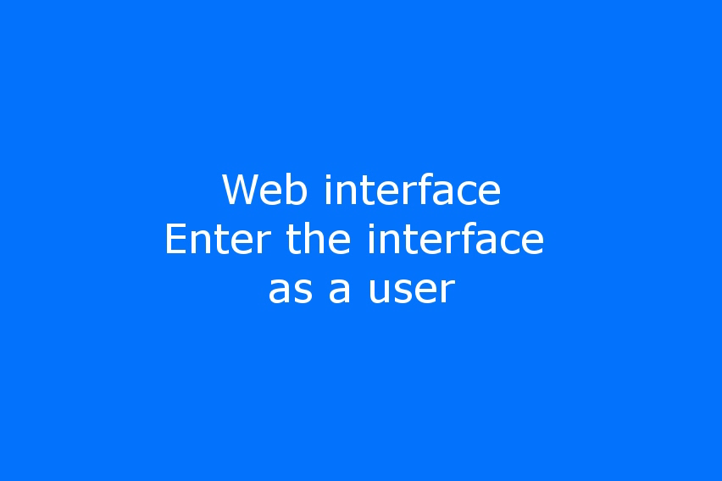
Web interface
Video: Open the Web interface and enter as user

Slide 5
FTP interface
Connection
Network connection to projector via IP address
Interface access rights
Username and password “root” – entire drive available
Purpose
Copy, read or remove files from the projector
Username and password “cps” – only LPC folder available
Linux client mode required (since LPC 11.00)
Retrieve projector info/settings such as port number, client version, etc

Slide 6
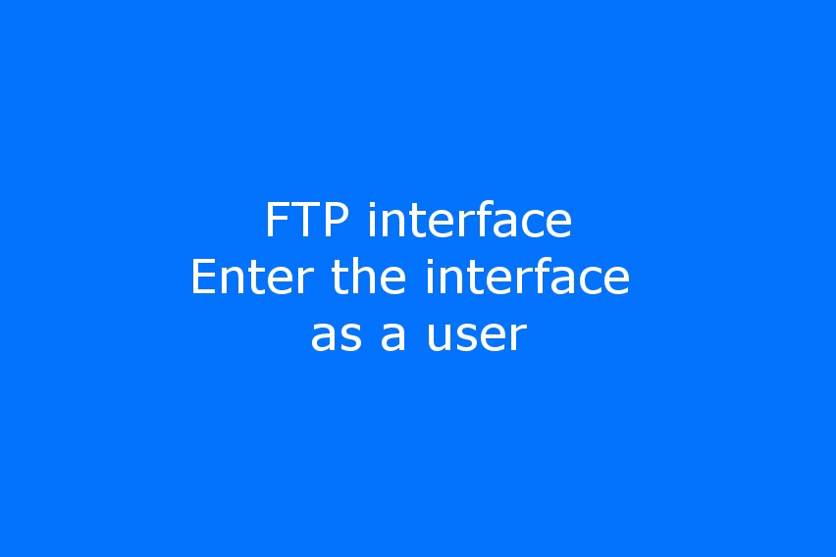
FTP interface
Video: Open the FTP interface and enter as user

Slide 7
Samba Share
Connection
Network or serial connection to projector via IP address or serial number
Folder access rights
Read-only
Purpose
To project or alter plot files
Retrieve projector info such as IP address, client version, etc
LPC.INI Parameters
AutoDeletePlotFiles
Read-write
0 – Retains the projected file in the plot folder after projection
1 – Deletes the projected file from the plot folder after projection
Linux client mode required (since LPC 11.00, LPC 11.20 or higher is recommended)

Slide 8
Samba Share
Folders available
Plot - A PLOT file placed here will be displayed by the projector
File system
File names
Files can be safely stored/ changed by rebooting the projector
Data - Displays files stored on the projector
Handbuch - Future space for storing the latest manuals
LPM - Future space for storing the latest LPM programs
Info - Stores the info.txt file (available since LPC 11.30)
Maximum of 8 letters for the file name and 3 letters for the file suffix
File names are not case sensitive

Slide 9
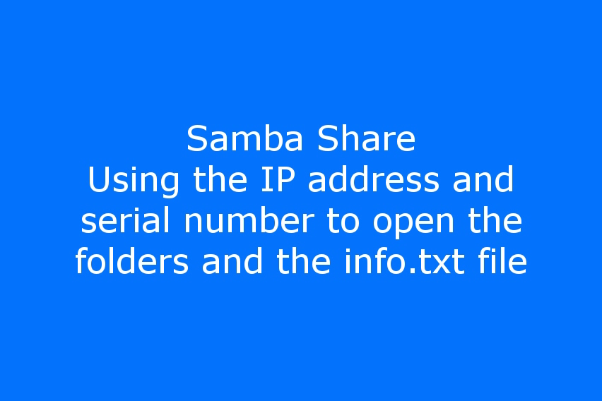
Samba Share
Video: Open the folder and info.txt file on the projector

Slide 10
HyperTerminal
Connection
Serial connection to projector
Default settings
Bits per second – 9600
Databits – 7
Parity - Even
Flow Control – None
Stop Bits - 1
Commands
HPGL commands
Z-commands
Retrievable information from the projector
Serial Number
Client version

Slide 11
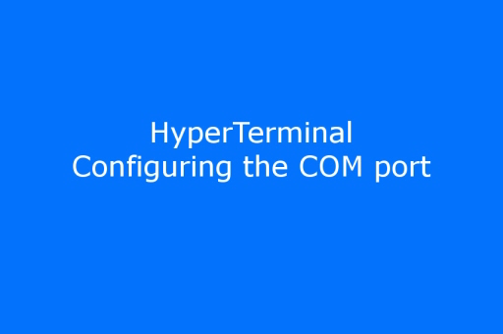
HyperTerminal
Video: Setup and sending a file to projector

Slide 12
Telnet
Connection
Network connection to projection via IP address
Timeout
STX and ETX commands do not work
Commands
Uses Port 23
HPGL commands
Z-commands
Retrievable information from the projector
Serial number
Client version

Slide 13
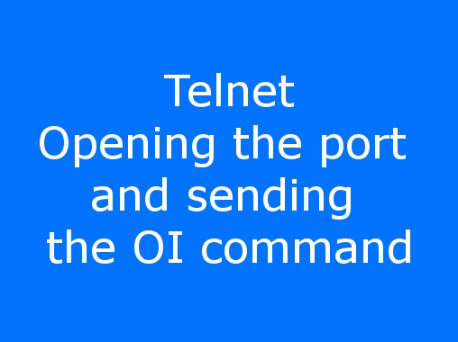
Telnet
Video: Opening the port and sending OI (not displayed) to projector

Slide 14
Projecting files stored on the projector via file name
Connection
Serial (e.g. HyperTerminal via COM port)
Preparing the projector
LPC.INI Parameter
Place PLOT file(s) into the \Data folder on the projector
Send file name to the projector via serial
Begin with command ZS followed by file name without extension and finish with semi-colon
UseFileNameFromNetCom=1
Example: ZS quad;
Network connection (e.g. HyperTerminal via Telnet)
Timeout= as long as you need to type the command

Slide 15
Projecting files stored on the projector via SPS, PLC
Connection
Projector connected via SPS, PLC interface (switch box or other)
Preparing the projector
LPC.INI Parameter
Place CSV and PLOT files into the \Data folder on the projector
CSV File Structure
<D0...D7>, “<command [parameter]>”, , ,
ParPortMode=1
Example: 00000001, “/FO quad.plt”, , ,
Example: 00000010, “/FO roof.plt”, , ,
Example: 00000011, “/BE”, , ,

Slide 16
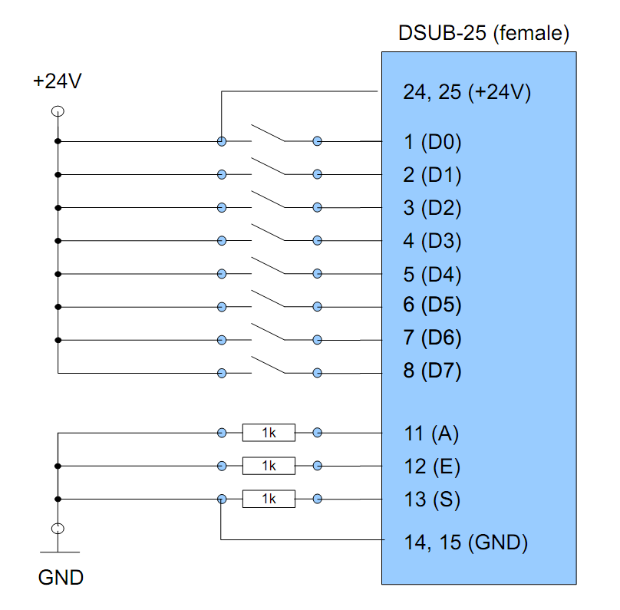
Projecting files stored on the projector via SPS, PLC
Tips when using SPS, PLC
Restart/reboot the projector via web interface after transfering a file to the data folder
Use an existing working CSV file as a template
Maximum file name length is 8 characters and the file suffix is always 3 characters long.
Only edit the CSV files in a text editor, never with a spreadsheet program (Excel)

Slide 17
Winsock
Connection
Based on the Telnet connection
Program
To be made by the customer
Procedure
Open the socket (IP address and port)
Send HPGL and Z-commands
Reaction speed
Depends on Timeout value
Close socket (releasing the IP address and port)
We have some sample code written in C# if required.

